Slide 1

FY 2025 BUDGET
Budget Guide

Slide 2
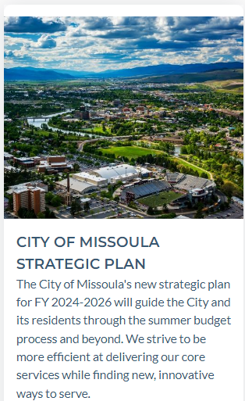
What is “the Budget?”
The budget is a plan for the provision of services and capital assets over a fiscal year.
The budget is guided by the strategic plan.
https://www.ci.missoula.mt.us/DocumentCenter/View/66300/Strategic-Plan-2024-2026

Slide 3
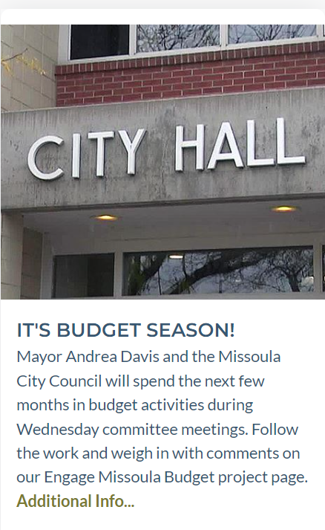
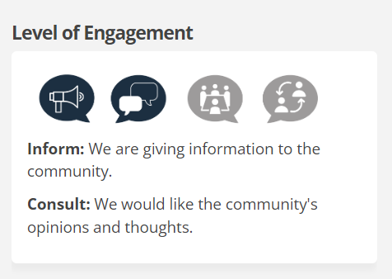
How do I find budget information?
ENGAGE MISSOULA
Summarized budget info
and public comment options.
Engage page is linked on the front page of the City website.

Slide 4
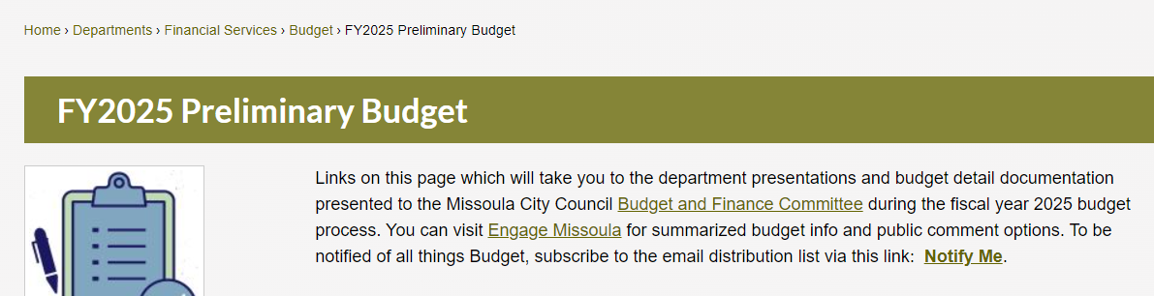
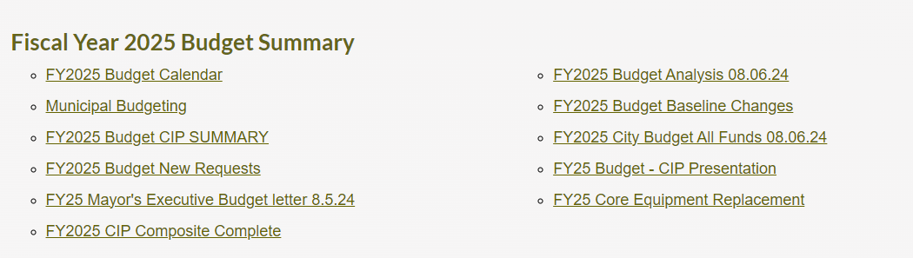
How do I find budget information?
https://www.ci.missoula.mt.us/3344/FY2025-Preliminary-Budget

Slide 5
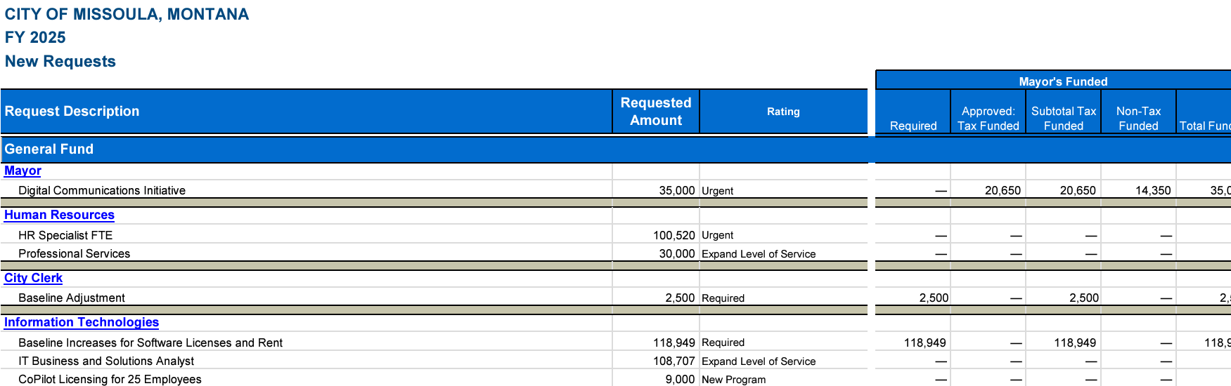
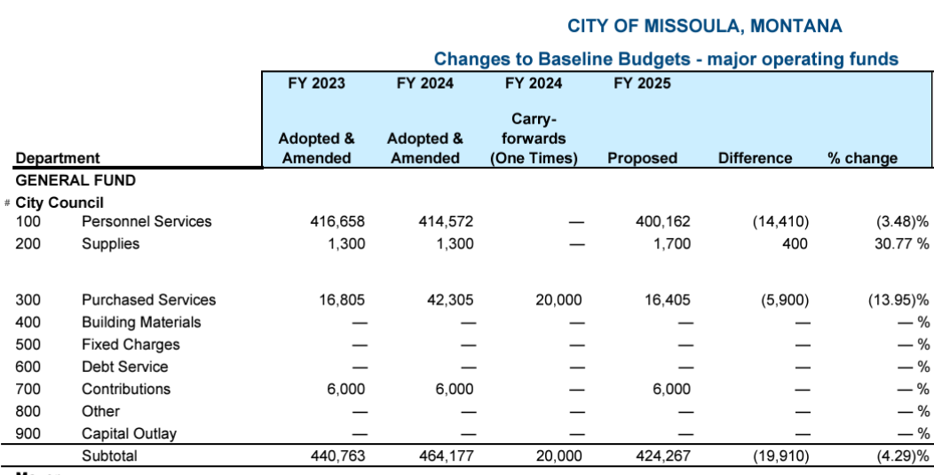
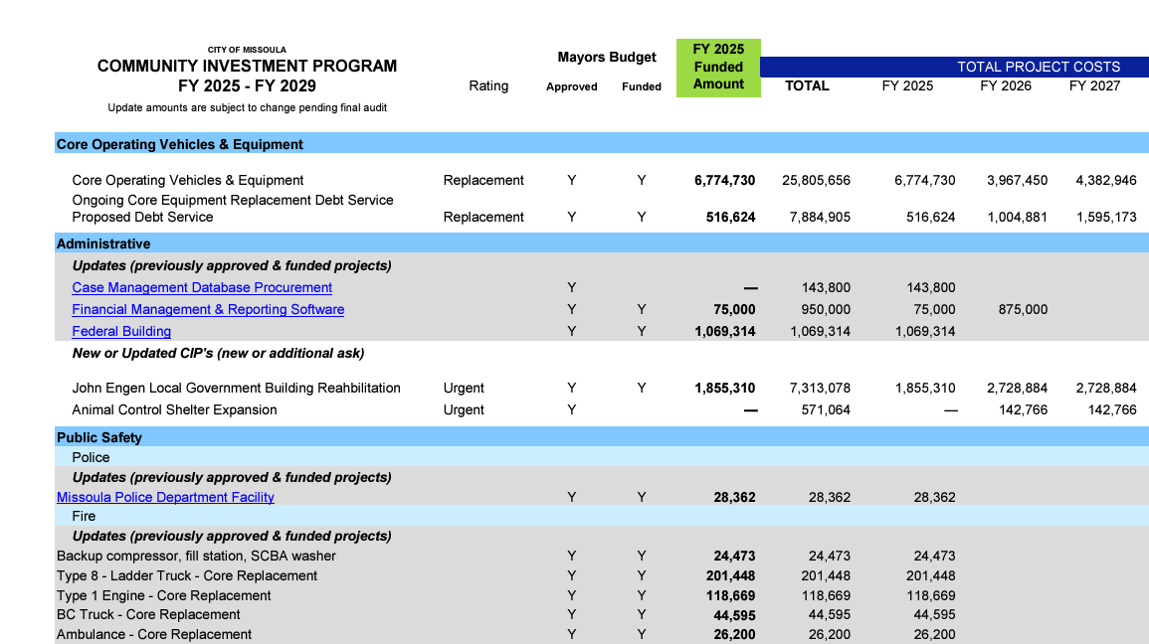
What makes up the budget?
New Requests
Baseline changes
Community Investment Program

Slide 6
How do I “read” the budget?
The City of Missoula budgets for more than $200 million of revenues and expenditures over 173 funds.
Four summary documents comprise the budget.
Line-Item budget
Community Improvement Program (CIP)
Baseline changes
New Requests
BUDGET
.

Slide 7
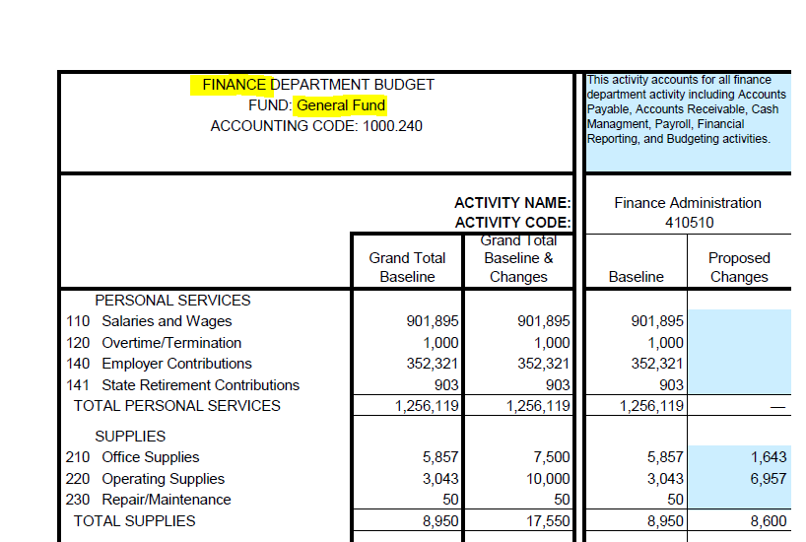
Line-Item Budget

Slide 8
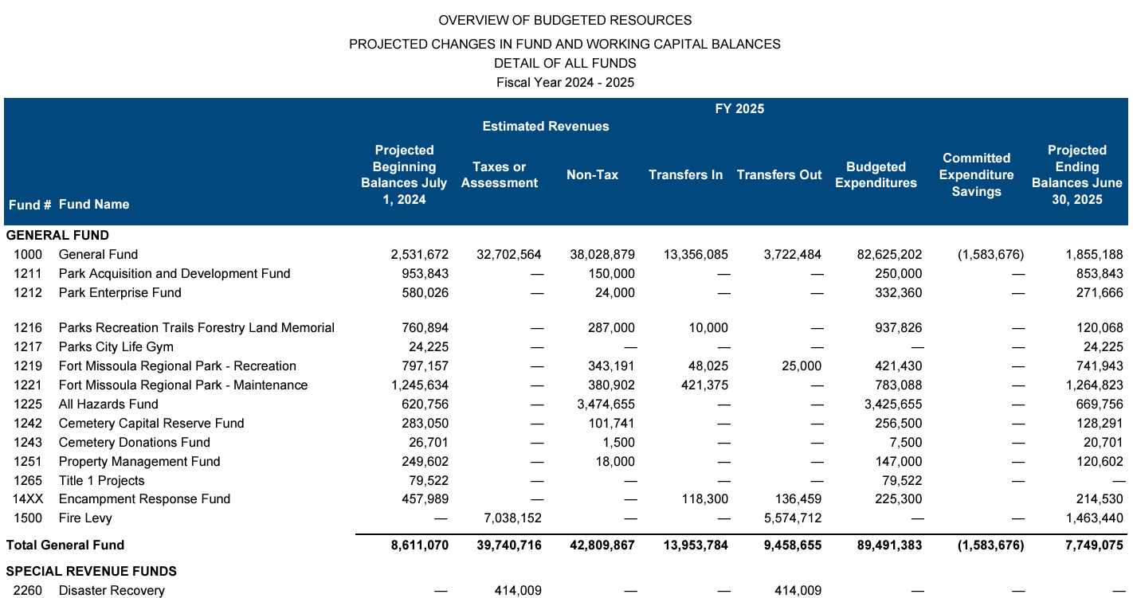
ALL BUDGETED FUNDS
Budget appropriations resolution source document

Slide 9
Budget
Montana Code Annotated 2021
TITLE 7. LOCAL GOVERNMENT
CHAPTER 6. FINANCIAL ADMINISTRATION AND TAXATION
Part 40. Local Government Budget Act
7-6-4003. Budget and levies supplied to department of administration.
A local government shall submit a complete copy of the final budget together with a statement of tax levies to the department of administration by the later of October 1 or 60 days after receipt of taxable values from the department of revenue.
Taxable value enables the City calculate the tax levy and determine levels of tax revenue to fund operations.
15-10-420. Procedure for calculating levy. <> The maximum number of mills that a governmental entity may impose is established by calculating the number of mills required to generate the amount of property tax actually assessed in the governmental unit in the prior year based on the current year taxable value, less the current year's newly taxable value, plus one-half of the average rate of inflation for the prior 3 years.

Slide 10
FY 2025 BUDGET
end

